Slide 1
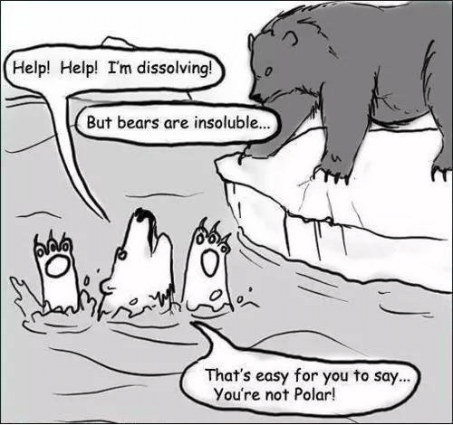

Slide 2
Krebsův cyklus, β-oxidace lipidů
Karel Kubíček

Slide 3
References:
Voet & Voet: Biochemistry, 4th Ed. 2011
Murray, Granner, Mayes, Rodwell: Harper‘s Illustrated Biochemistry, 26th Ed. 2003
Lehninger, Nelson, Cox: Principles of Biochemistry, 2nd Ed.
http://www.wikipedia.com
http://www.nobel.se
Introduction to Biophysics – presentations by KK

Slide 4
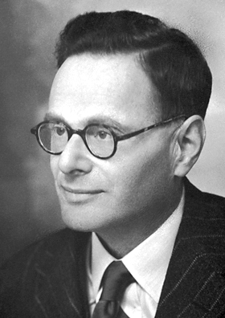
Citric acid cycle aka CAC
aka
Tricarboxcyclic acid cycle aka TCA
aka
Krebs cycle
Sir Hans Adolf Krebs 1900 – 1981:
. German-born British physician and biochemist
. the pioneer scientist in study of cellular respiration
. best known for his discoveries of two important chemical reactions in the body, i) urea cycle and ii) the citric acid cycle
. Nobel Prize in Physiology or Medicine in 1953.
. With Hans Kornberg, he also discovered the glyoxylate cycle (found in plants, bacteria, protists, and fungi)
aka: also known as

Slide 5
Krebs cycle is complicated but there is a way how to rember its intermediates ☺
Brno is nice place to live in!!!
And it is because (we wish it so☺):
Our City Is Kept Safe and Secure From Mobsters

Slide 6
Our City Is Kept Safe and Secure From Mobsters
Oxalacetate
Citrate
Isocitrate
α-Ketoglutamate
Succinyl-coA
Succinate
Fumarate
Malate

Slide 7
Outline
Glucose pyruvate
c-c-c-c-c-c c-c-c
pyruvate Acetyl CoA citric acid
c-c-c c-c c-c-c-c
CO₂ CO₂
Oxalacetate
c-c-c-c

Slide 8
Outline
Glucose pyruvate
c-c-c-c-c-c c-c-c
pyruvate Acetyl CoA citric acid
c-c-c c-c c-c-c-c
CO₂ CO₂
Oxalacetate
c-c-c-c

Slide 9
Outline
Glucose pyruvate
c-c-c-c-c-c c-c-c
pyruvate Acetyl CoA citric acid
c-c-c c-c c-c-c-c

Slide 10
Outline
Glucose pyruvate
c-c-c-c-c-c c-c-c
pyruvate Acetyl CoA citric acid
c-c-c c-c c-c-c-c
Oxalacetate
c-c-c-c

Slide 11
Outline
Glucose pyruvate
c-c-c-c-c-c c-c-c
pyruvate Acetyl CoA citric acid
c-c-c c-c c-c-c-c
Oxalacetate
c-c-c-c

Slide 12
Outline
Glucose pyruvate
c-c-c-c-c-c c-c-c
pyruvate Acetyl CoA citric acid
c-c-c c-c c-c-c-c-c-c
CO₂ CO₂
Oxalacetate
c-c-c-c

Slide 13
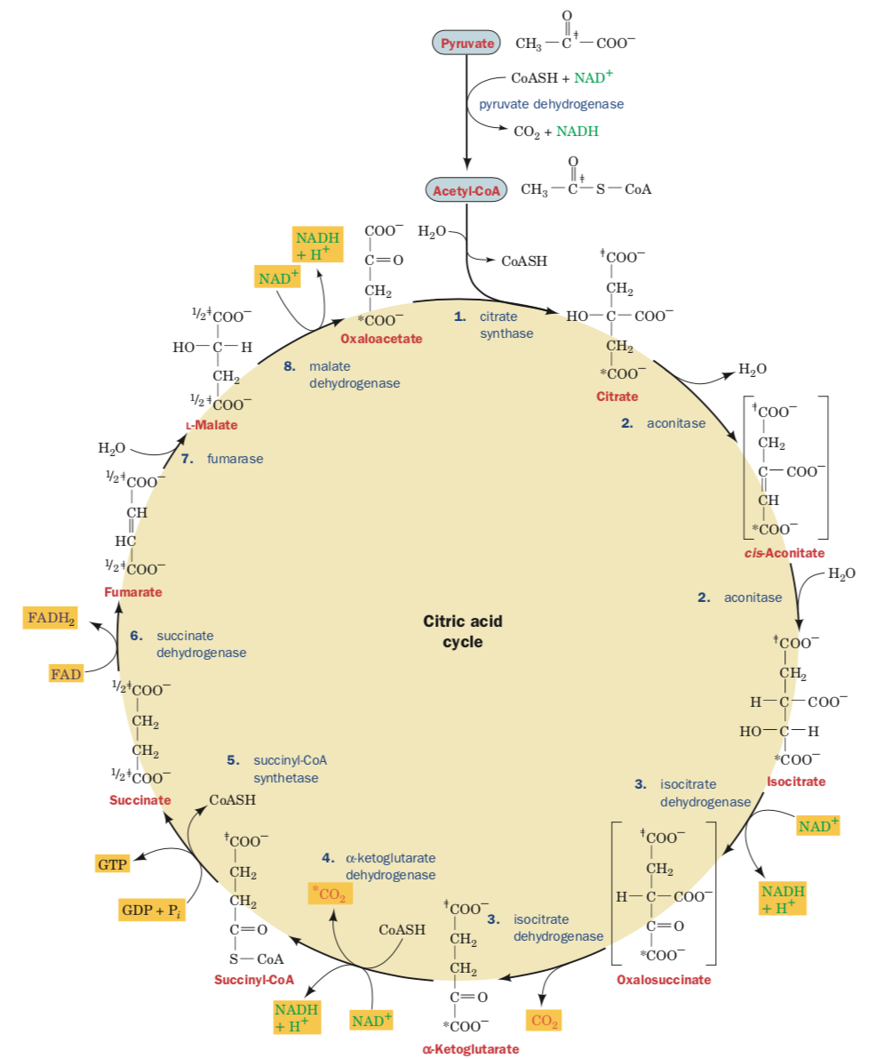
Krebs cycle
Reactants / products
Compounds of the cycle
Enzymes
[intermediates]

Slide 14
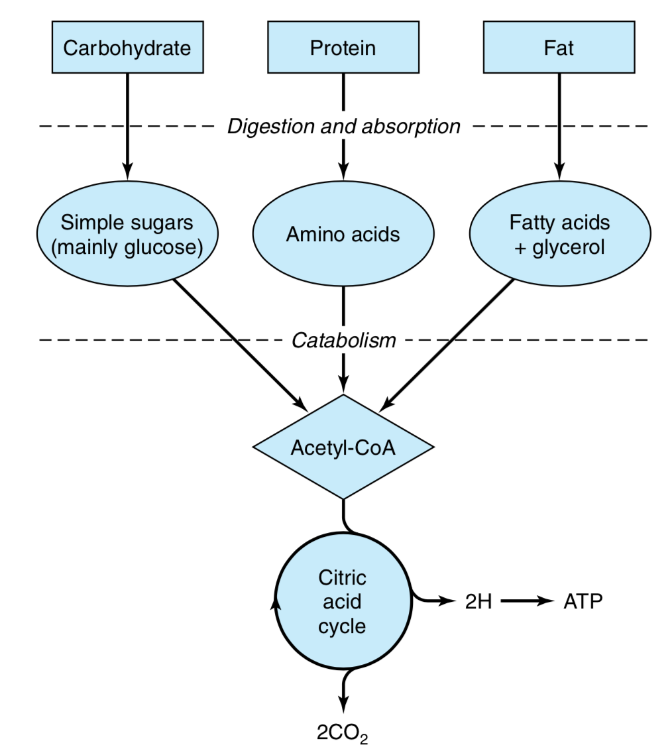

Slide 15
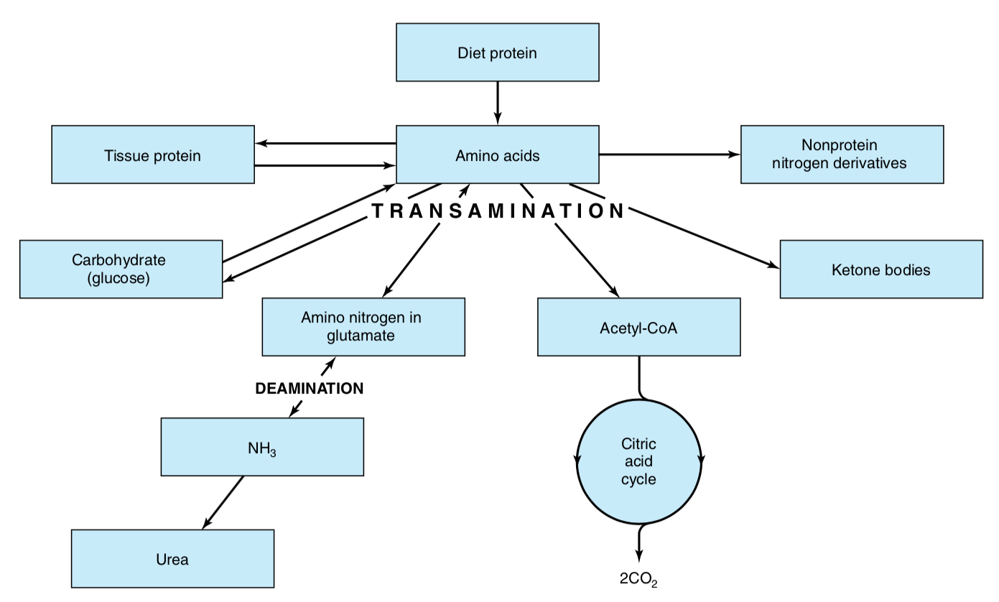

Slide 16
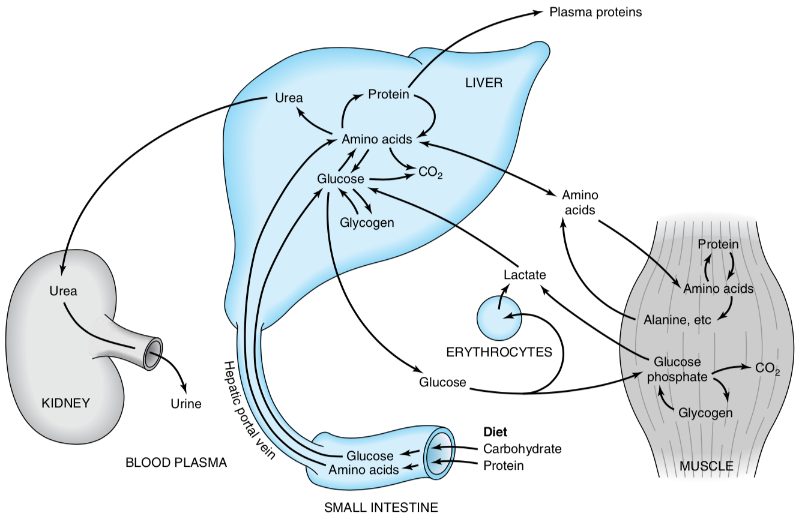

Slide 17
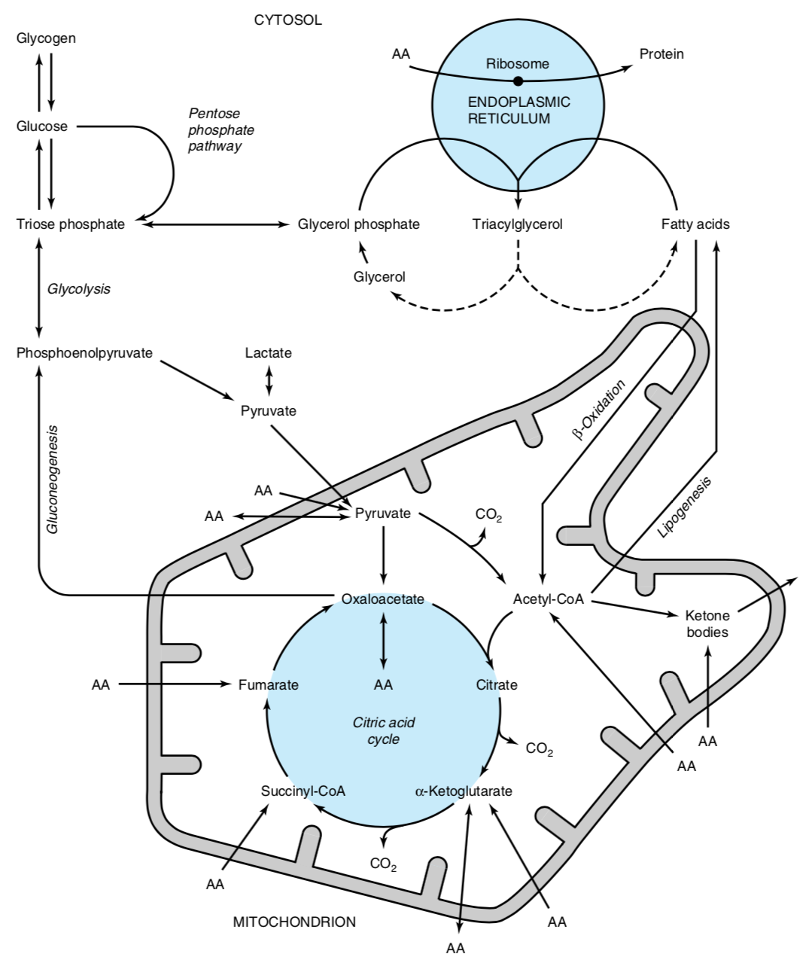

Slide 18
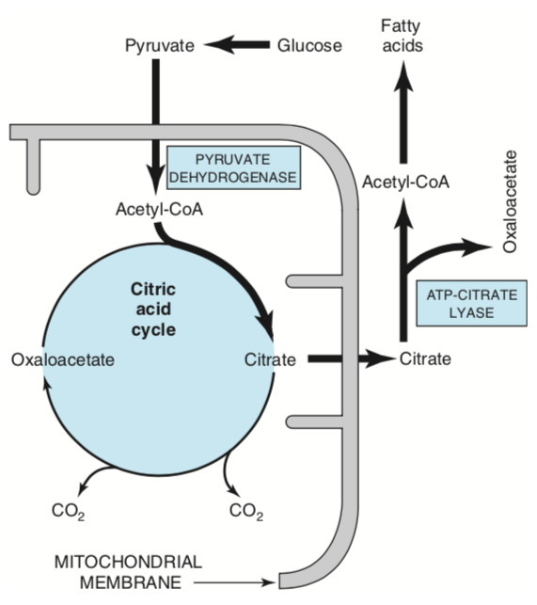

Slide 19
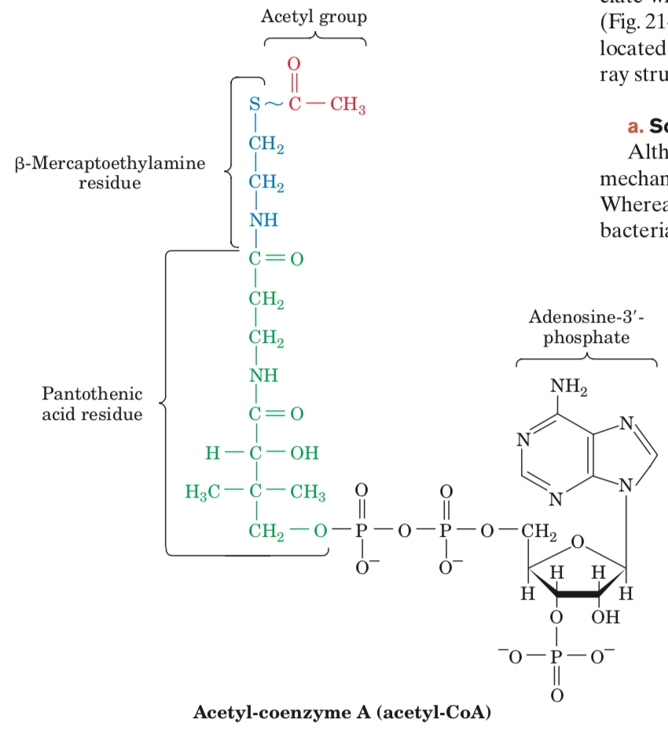
Players of the game

Slide 20
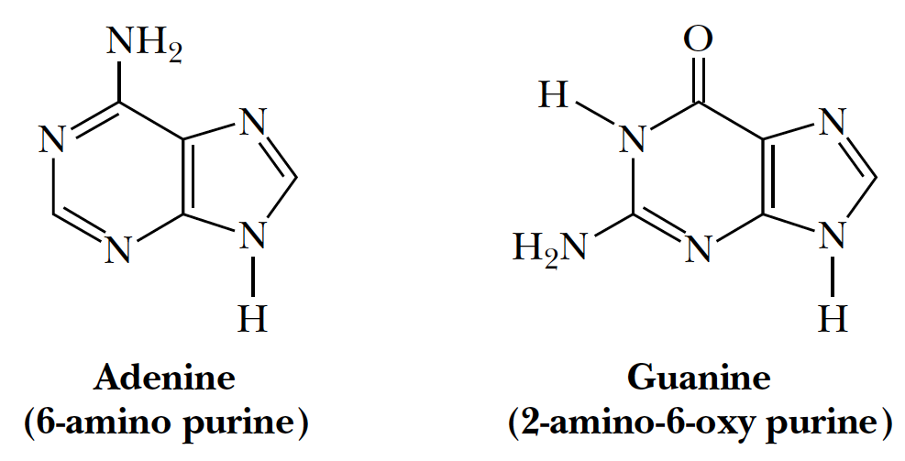
Purine (R)

Slide 21
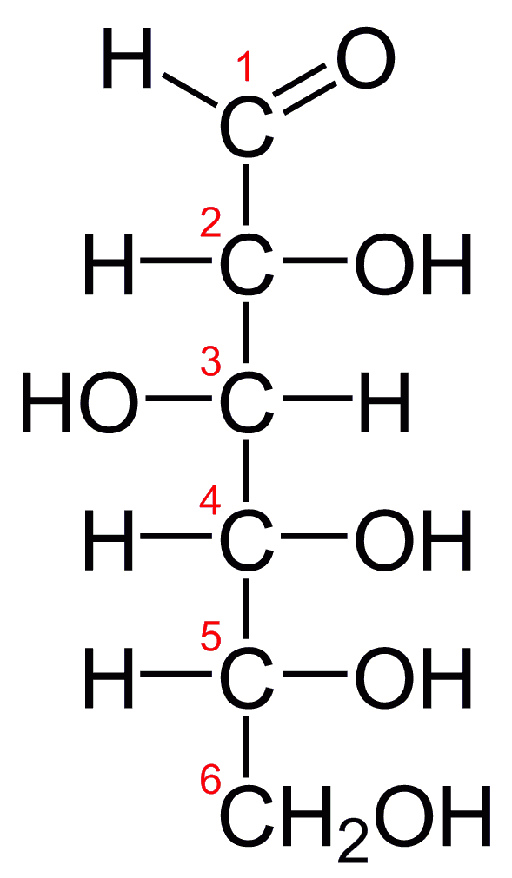
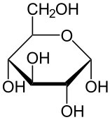
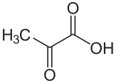
glucose pyruvate

Slide 22
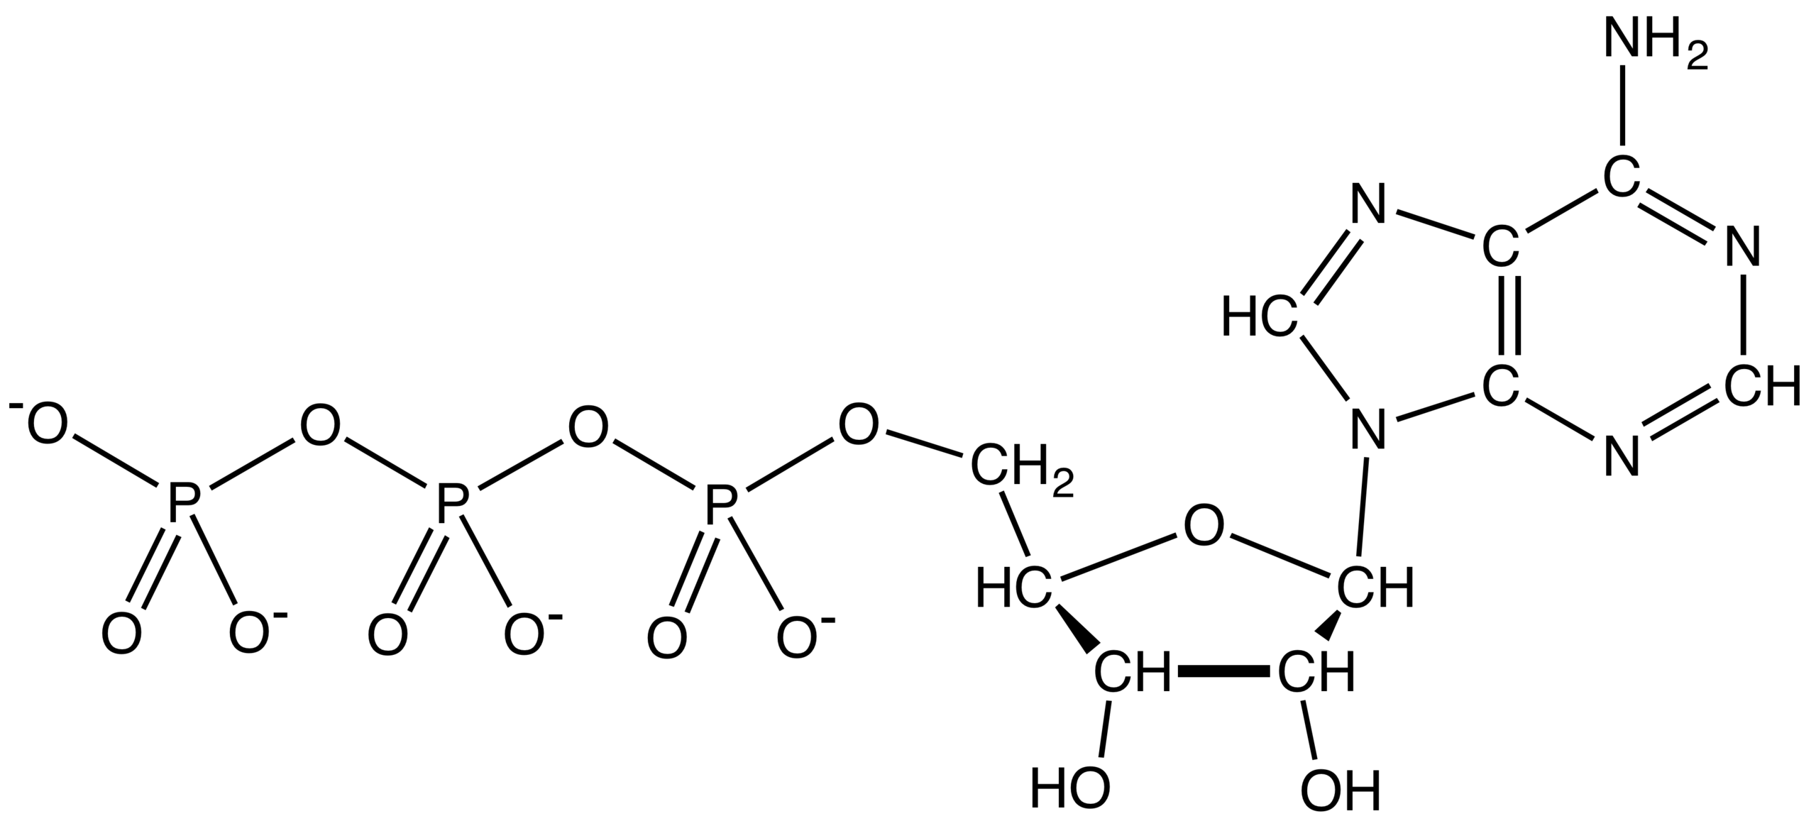
A
T D M
P

Slide 23
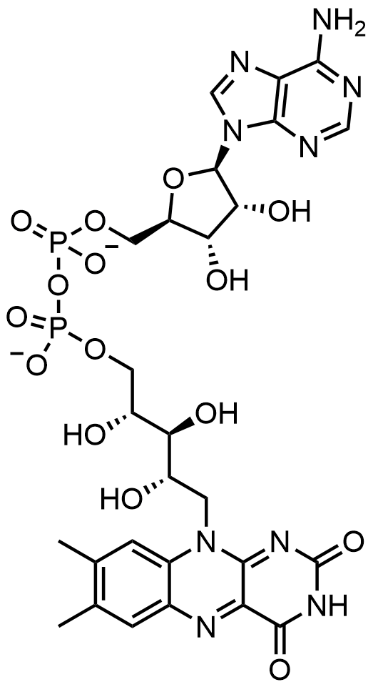
flavin adenine dinucleotide (FAD)

Slide 24
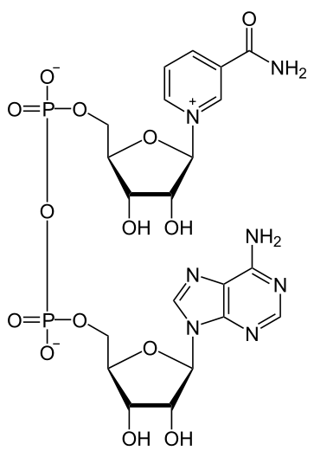
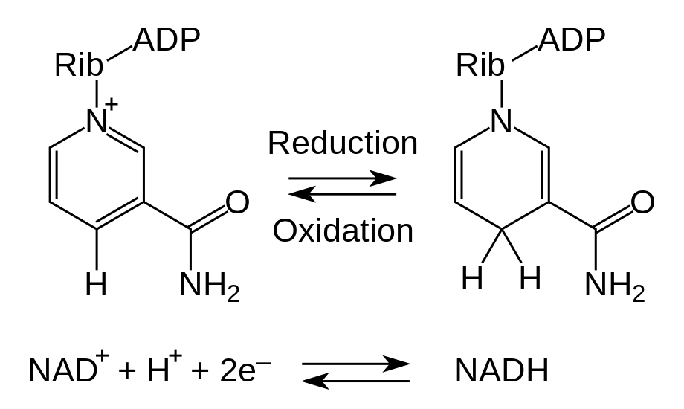
Nicotinamide adenine dinucleotide (NAD)

Slide 25
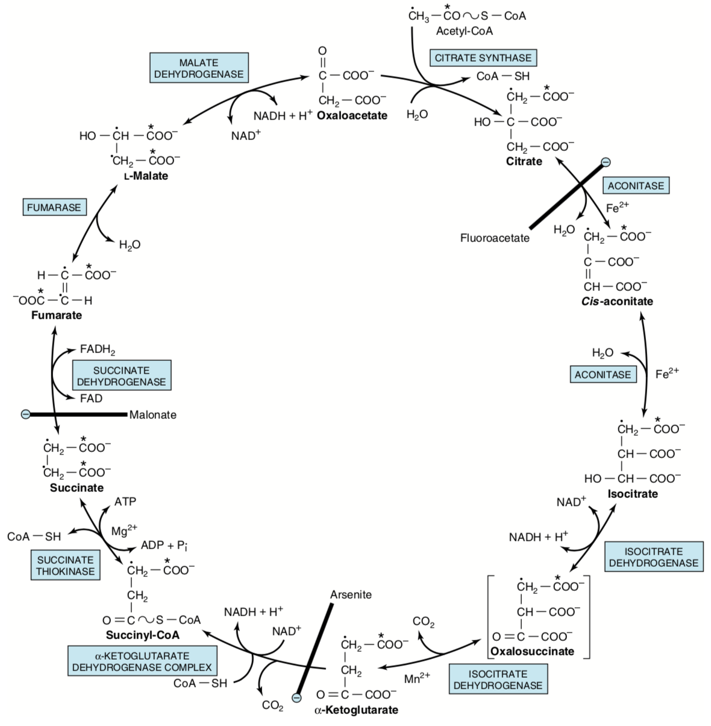
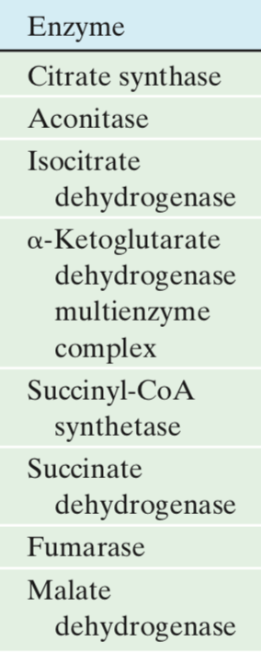

Slide 26
Protein database – PDB
WWW.RCSB.ORG
Vizualization programs
PyMol
Chimera
VMD
MolMol
RasMol
Insight II

Slide 27
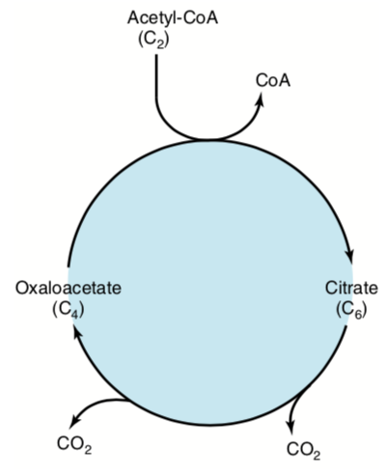

Slide 28
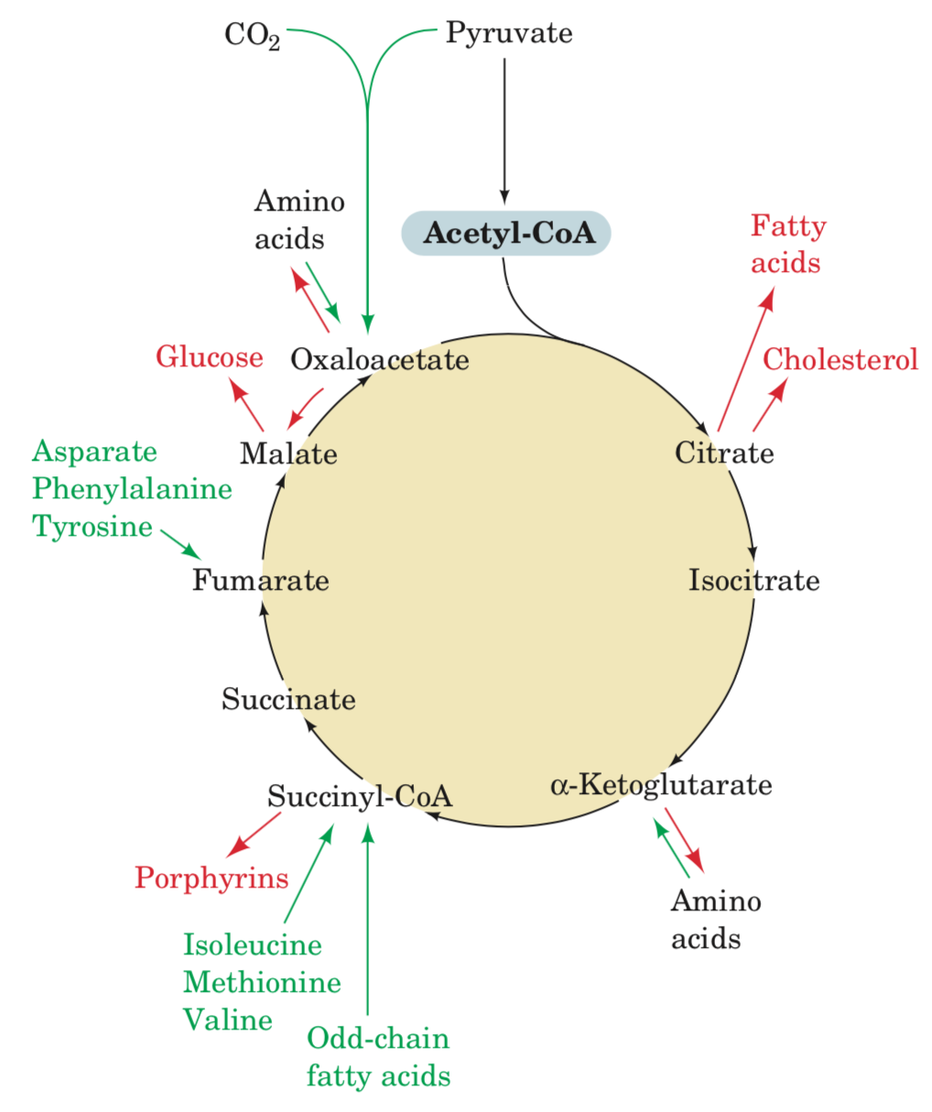
Anaplerotic intermediates
Cataplerotic -----“-----

Slide 29
???

Slide 30
Nucleoside-diphosphate kinase catalyzes the exchange of terminal phosphate between different nucleoside diphosphates and triphosphates in a reversible manner to produce nucleotide triphosphates.

Slide 31
The citric acid cycle, the common mode of oxidative metabolism in most organisms, is mediated by eight enzymes that collectively convert 1 acetyl-CoA to 2 CO₂ molecules so as to yield 3 NADHs, 1 FADH₂, and 1 GTP (or ATP). The NADH and FADH2 are oxidized by O₂ in the electron-transport chain with the concomitant synthesis of around 11 more ATPs, yielding a total of about 12 ATPs for one turn of the citric acid cycle.
.Several anabolic pathways cataplerotically utilize citric acid cycle intermediates as starting materials. These essential substances are replaced by anaplerotic reactions of which the major one is synthesis of oxaloacetate from pyruvate and CO₂ by pyruvate carboxylase.
The enzymes of the citric acid cycle act as a functional unit that keeps pace with the metabolic demands of the cell. The flux-controlling enzymes appear to be citrate synthase, isocitrate dehydrogenase, and α-ketoglutarate dehydrogenase. Their activities are controlled by substrate availability, product inhibition, inhibition by cycle intermediates, and activation by Ca²⁺.

Slide 32
Oxidation of Fatty Acids
Activation
Transport
Oxidation

Slide 33
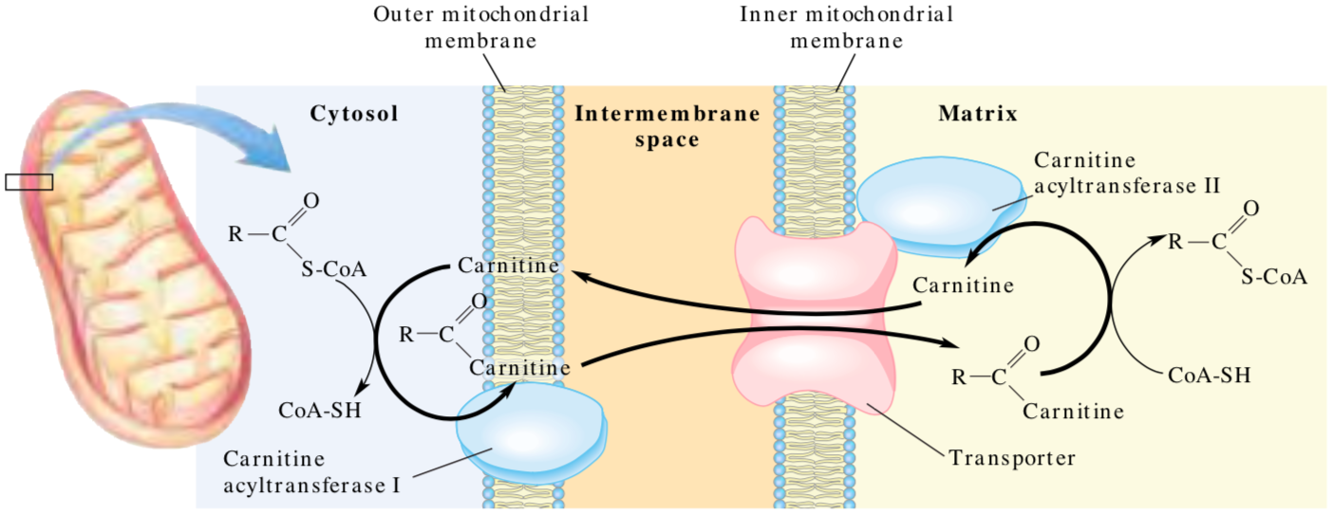

Slide 35
Acyl carnitine trnasLOCASE

Slide 36
Activation

Slide 37
Activation Transport

Slide 38
Activation Transport Oxidation

Slide 39
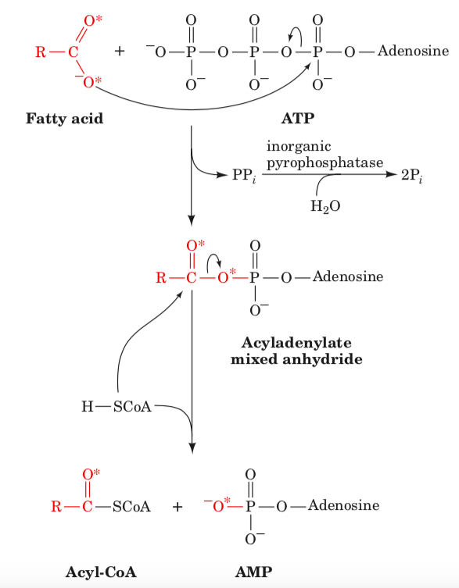
Activation

Slide 40
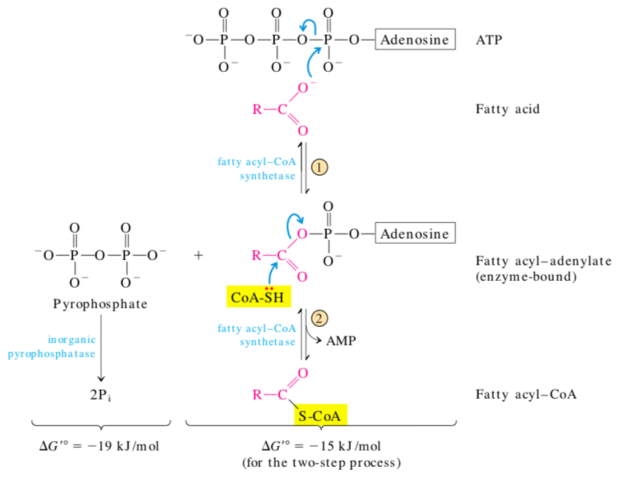
Activation

Slide 41
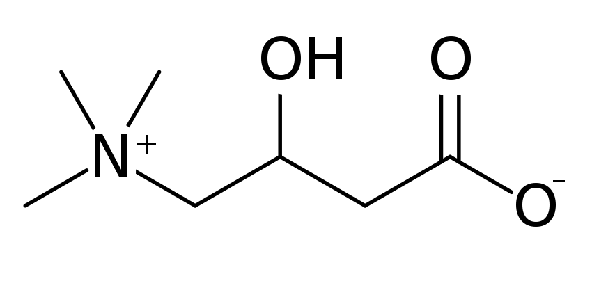
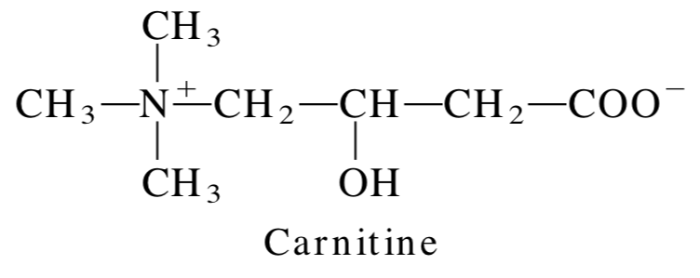
Transport
quaternary ammonium compound
involved in metabolism in most mammals, plants and some bacteria
may exist in two isomers, labeled D-carnitine and L-carnitine, as they are optically active
@ RT white powder, water-soluble zwitterion with low toxicity
in animals as the L-enantiomer only, and D-carnitine is toxic => inhibits L-carnitine
it is most accumulated in cardiac and skeletal muscles as it accounts for 0.1% of its dry matter
synthesized from lysine side chains to keep up with the needs of energy production
some individuals with genetic or medical disorders (like preterm infants) cannot make enough, so this makes carnitine a conditionally essential nutrient for them

Slide 42
Transport
CAT II
CAT I

Slide 43
Transport
Carnitine-acylcarnitine translocase
CAT I

Slide 44
Transport
Carnitine-acylcarnitine translocase
CAT I

Slide 45
Transport
CAT II
Carnitine-acylcarnitine translocase
CAT I

Slide 46
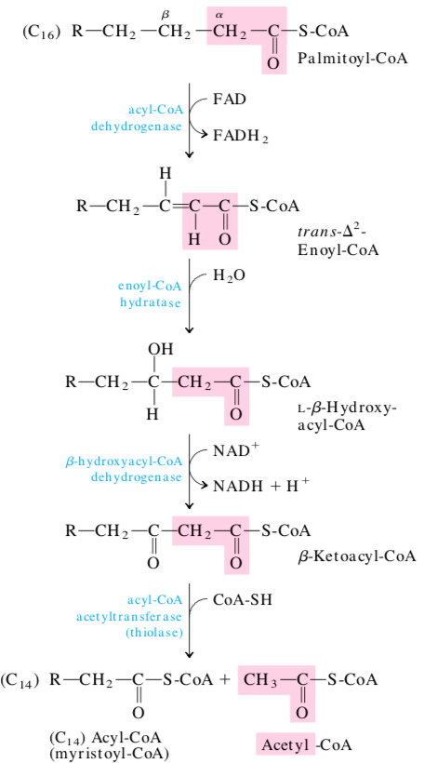
Oxidation

Slide 48
1
2
3
4
5
6

Slide 49
1
2
3
4
5
6

Slide 50
1
2
3
4
5
6
1
2
3
4
5
6
7

Slide 56
